Slide 1

Southside International Church
Property Development …
Discovering a Way Forward

Slide 2
Southside International Church
Property Development …
Discovering a Way Forward
      The Journey So Far
      We Are Southside
      Hearing One Another

Slide 3
Southside International Church
Property Development …
Discovering a Way Forward
The Journey So Far

Slide 4
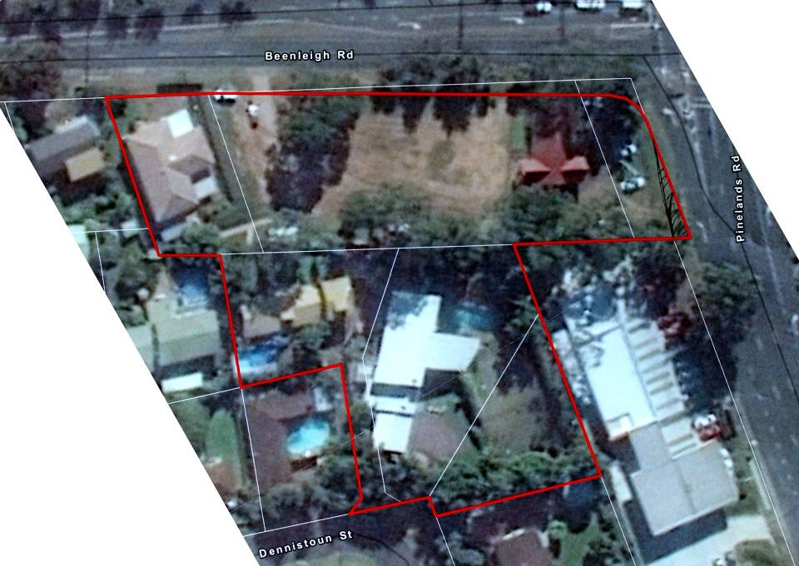

Slide 5
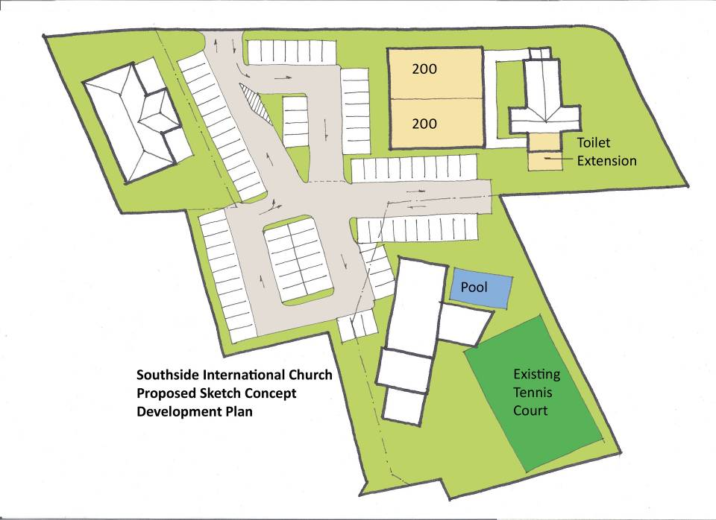

Slide 6
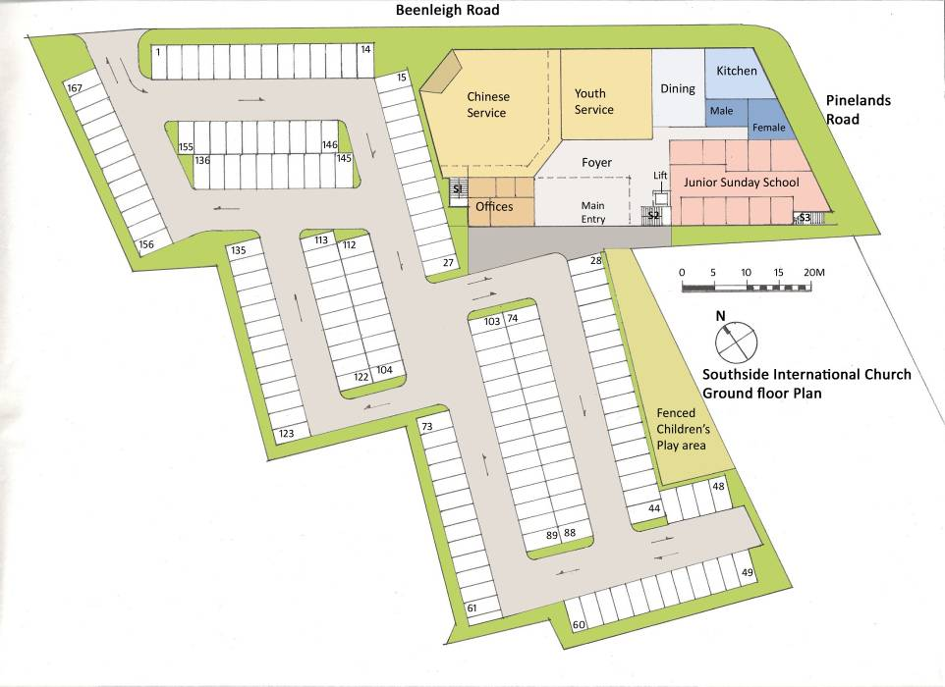

Slide 7
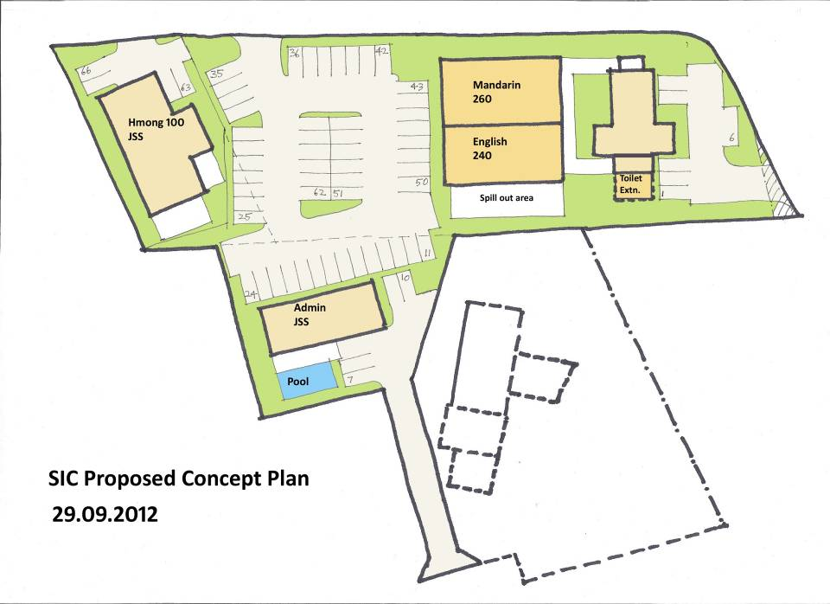

Slide 8
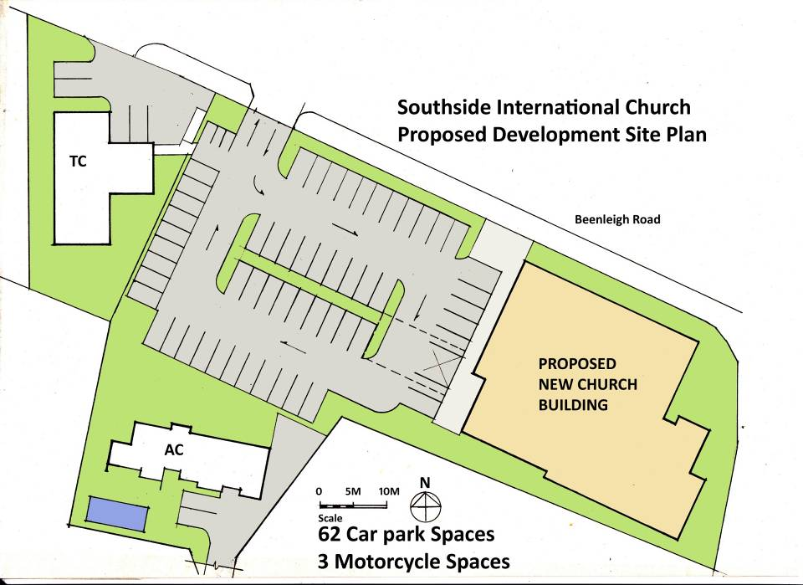

Slide 9
Discovering a Way Forward
The Journey So Far…
    Finances
      Cost Estimate by Designer … $4mil +
      $300k + given to date
      Have paid out all loans
      Paid various consultants
      Amount in hand … $174k +

Slide 10
Southside International Church
Property Development …
Discovering a Way Forward
We Are Southside

Slide 11
Discovering a Way Forward
We are Southside …
  Glorifying God as one multicultural integrated family , fulfilling the Great Commandment and Commission of our Lord Jesus Christ

Slide 12
Discovering a Way Forward
We are Southside …
  Outward Focus
  Multi-Cultural Fellowship
  Prayer
  God’s Word
  Discipleship
  Inspiring Worship
  Christian & Missionary Alliance

Slide 13

Southside International Church a Christian and Missionary Alliance Church
… Christ centred
… Spirit empowered
… Mission focused

Slide 14
Discovering a Way Forward
We are Southside …
    Winning
    Building
    Equipping
    Multiplying
    Sending

Slide 15
Discovering a Way Forward
The Journey So Far…
    Growth not determined by buildings
    Stay on our existing site
    An investment of $4mil+ is not value for money given small benefit
    BCC Compliance a priority

Slide 16
Discovering a Way Forward
    People are more important than Buildings
    One Church … Different Congregations
    Concurrent Sunday Services +++
    Increase capacity with modest low cost proposal

Slide 17
Southside International Church
Property Development …
Discovering a Way Forward
Hearing One Another

