Slide 1
Fan the flame
2 Timothy 1:6-7
6-1-19

Slide 2
- Work harder
- Exercise more
- Serve God?

Slide 3
2 Timothy 1:5-8
I am reminded of your sincere faith, which first lived in your grandmother Lois and in your mother Eunice and, I am persuaded, now lives in you also. For this reason I remind you to fan into flame the gift of God, which is in you through the laying on of my hands. For the Spirit God gave us does not make us timid, but gives us power, love and self-discipline. So do not be ashamed of the testimony about our Lord or of me his prisoner. Rather, join with me in suffering for the gospel, by the power of God.

Slide 4
2 Timothy 1:5-8
I am reminded of your sincere faith, which first lived in your grandmother Lois and in your mother Eunice and, I am persuaded, now lives in you also. For this reason I remind you to fan into flame the gift of God, which is in you through the laying on of my hands. For the Spirit God gave us does not make us timid, but gives us power, love and self-discipline. So do not be ashamed of the testimony about our Lord or of me his prisoner. Rather, join with me in suffering for the gospel, by the power of God.

Slide 5
Spiritual gifts

Slide 6
Spiritual gifts
How do I find mine?

Slide 7
Spiritual gifts
1. Ask for elders to pray over you
2. Step out in faith

Slide 8
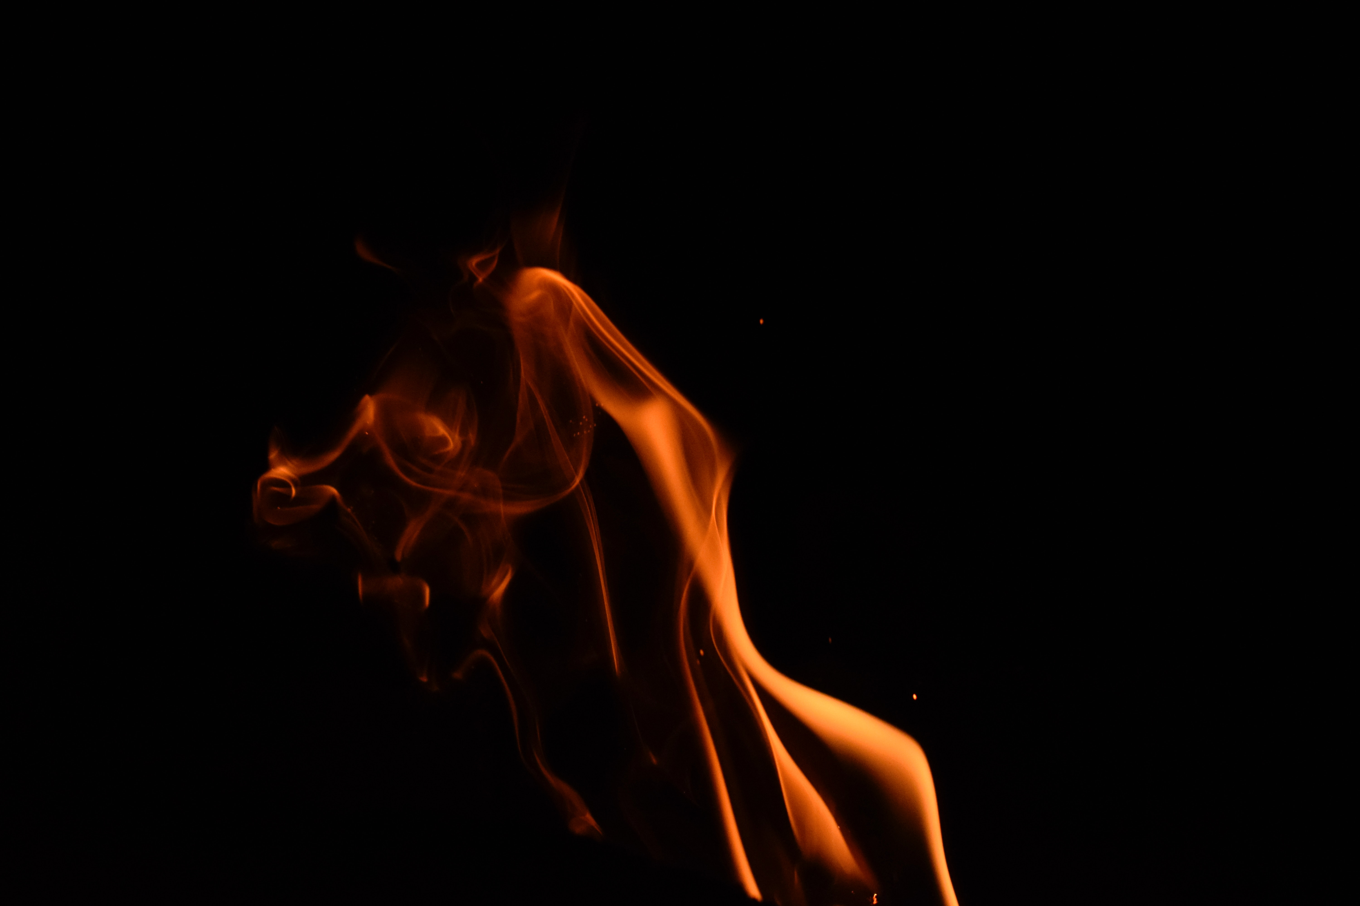
Fanning the flame

Slide 9
Fanning the flame
I am reminded of your sincere faith, which first lived in your grandmother Lois and in your mother Eunice and, I am persuaded, now lives in you also. For this reason I remind you to fan into flame the gift of God, which is in you through the laying on of my hands. For the Spirit God gave us does not make us timid, but gives us power, love and self-discipline. So do not be ashamed of the testimony about our Lord or of me his prisoner. Rather, join with me in suffering for the gospel, by the power of God.

Slide 10
Fanning the flame
I am reminded of your sincere faith, which first lived in your grandmother Lois and in your mother Eunice and, I am persuaded, now lives in you also. For this reason I remind you to fan into flame the gift of God, which is in you through the laying on of my hands. For the Spirit God gave us does not make us timid, but gives us power, love and self-discipline. So do not be ashamed of the testimony about our Lord or of me his prisoner. Rather, join with me in suffering for the gospel, by the power of God.

Slide 11
Fanning the flame
Without timidity
Power
Love
Self-discipline
Learn
Practise

Slide 12
I am reminded of your sincere faith, which first lived in your grandmother Lois and in your mother Eunice and, I am persuaded, now lives in you also. For this reason I remind you to fan into flame the gift of God, which is in you through the laying on of my hands. For the Spirit God gave us does not make us timid, but gives us power, love and self-discipline. So do not be ashamed of the testimony about our Lord or of me his prisoner. Rather, join with me in suffering for the gospel, by the power of God.

Slide 13
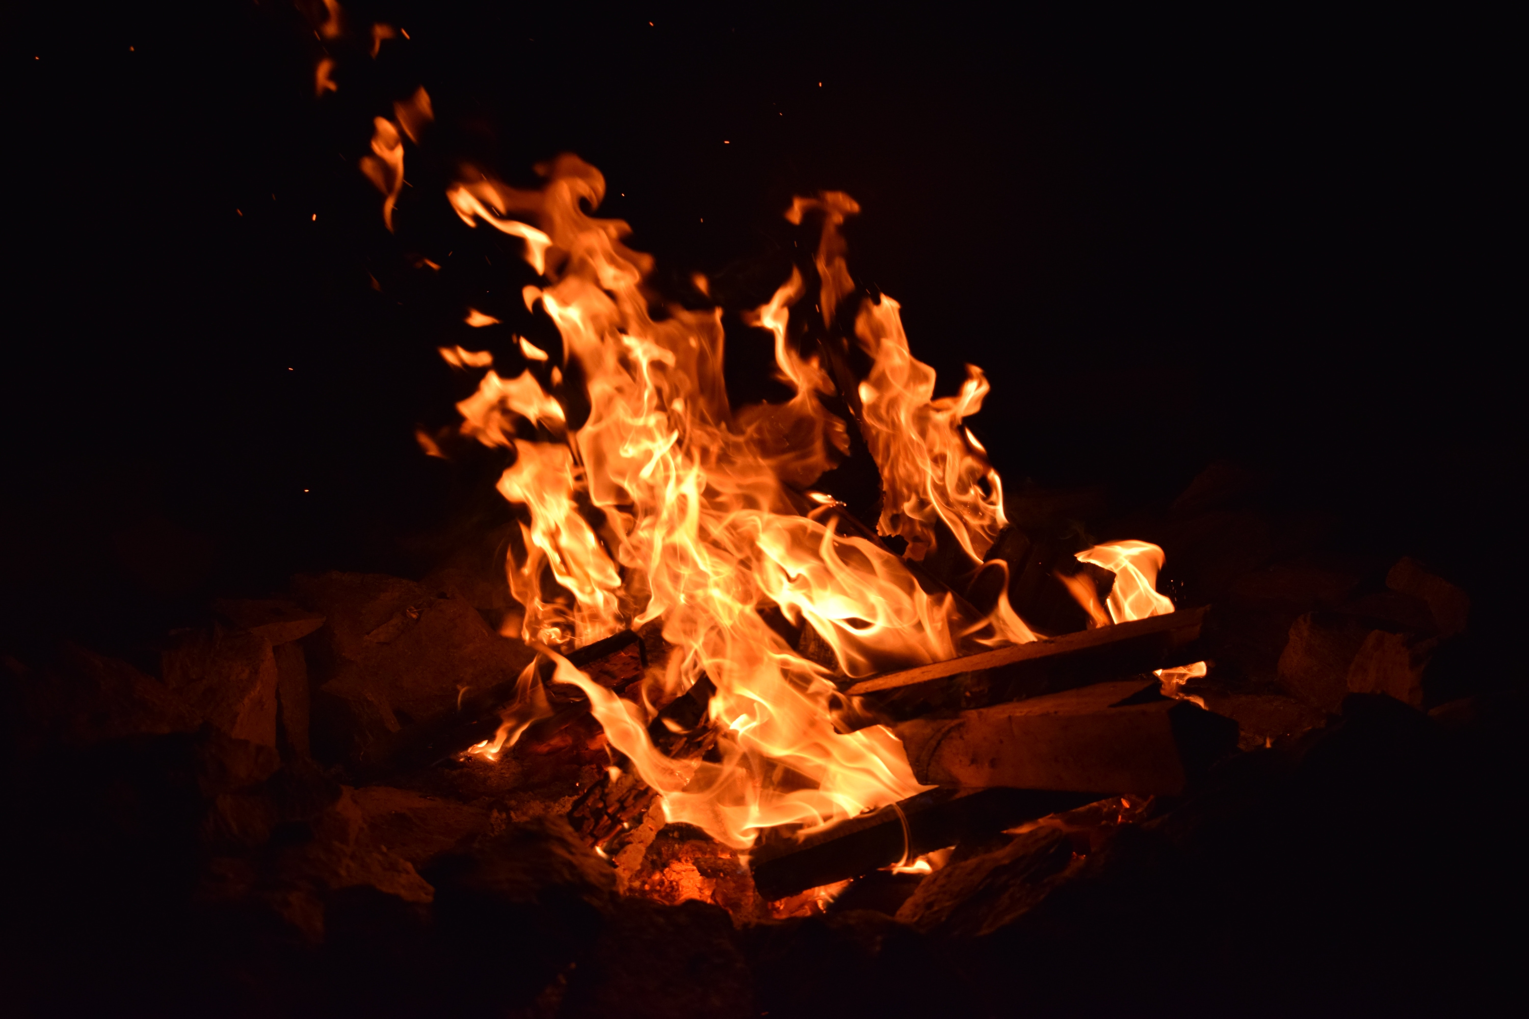
By the power of God
I am reminded of your sincere faith, which first lived in your grandmother Lois and in your mother Eunice and, I am persuaded, now lives in you also. For this reason I remind you to fan into flame the gift of God, which is in you through the laying on of my hands. For the Spirit God gave us does not make us timid, but gives us power, love and self-discipline. So do not be ashamed of the testimony about our Lord or of me his prisoner. Rather, join with me in suffering for the gospel, by the power of God.

Slide 14
2 Timothy 4:2-5
Preach the word; be prepared in season and out of season; correct, rebuke and encourage—with great patience and careful instruction. For the time will come when people will not put up with sound doctrine. Instead, to suit their own desires, they will gather around them a great number of teachers to say what their itching ears want to hear. They will turn their ears away from the truth and turn aside to myths.
But you, keep your head in all situations, endure hardship, do the work of an evangelist, discharge all the duties of your ministry.

Slide 15
2 Timothy 1:5-8
I am reminded of your sincere faith, which first lived in your grandmother Lois and in your mother Eunice and, I am persuaded, now lives in you also. For this reason I remind you to fan into flame the gift of God, which is in you through the laying on of my hands. For the Spirit God gave us does not make us timid, but gives us power, love and self-discipline. So do not be ashamed of the testimony about our Lord or of me his prisoner. Rather, join with me in suffering for the gospel, by the power of God.

