Slide 1
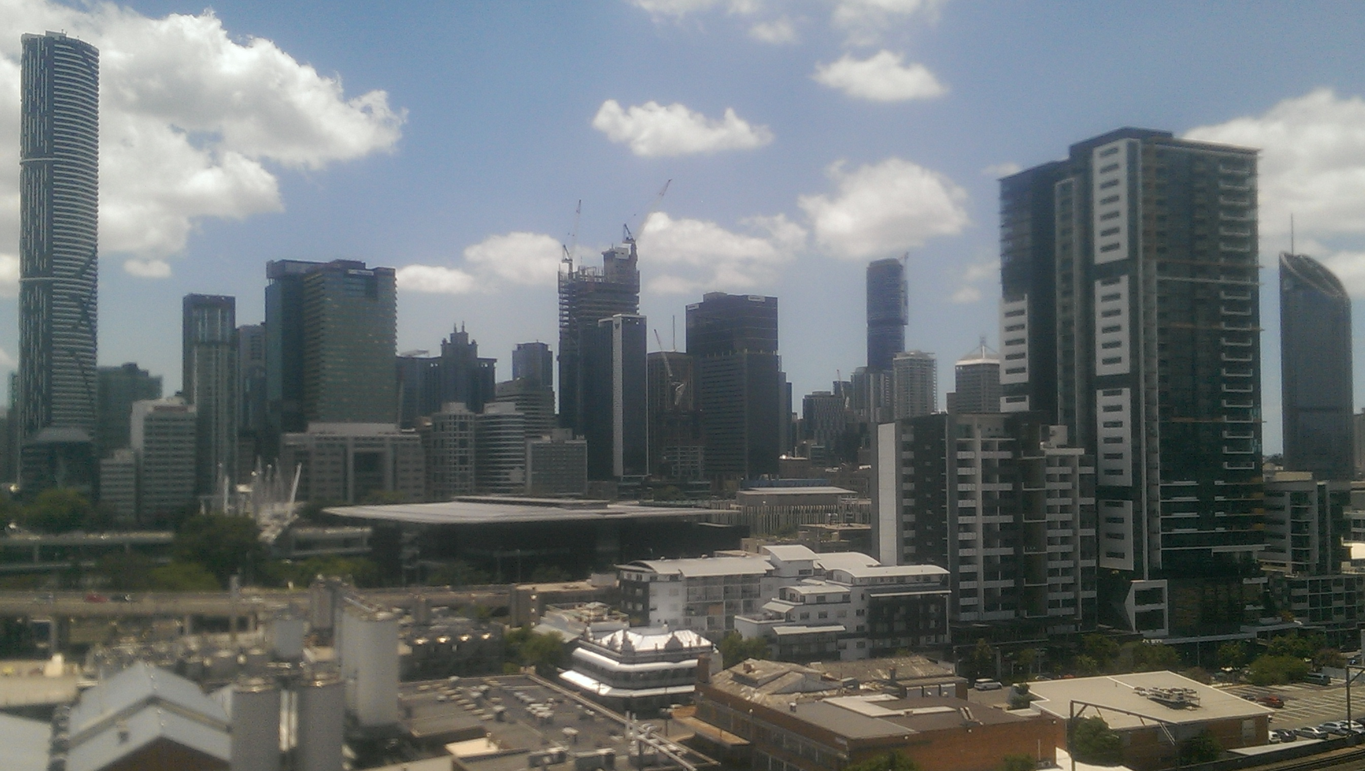

Slide 2
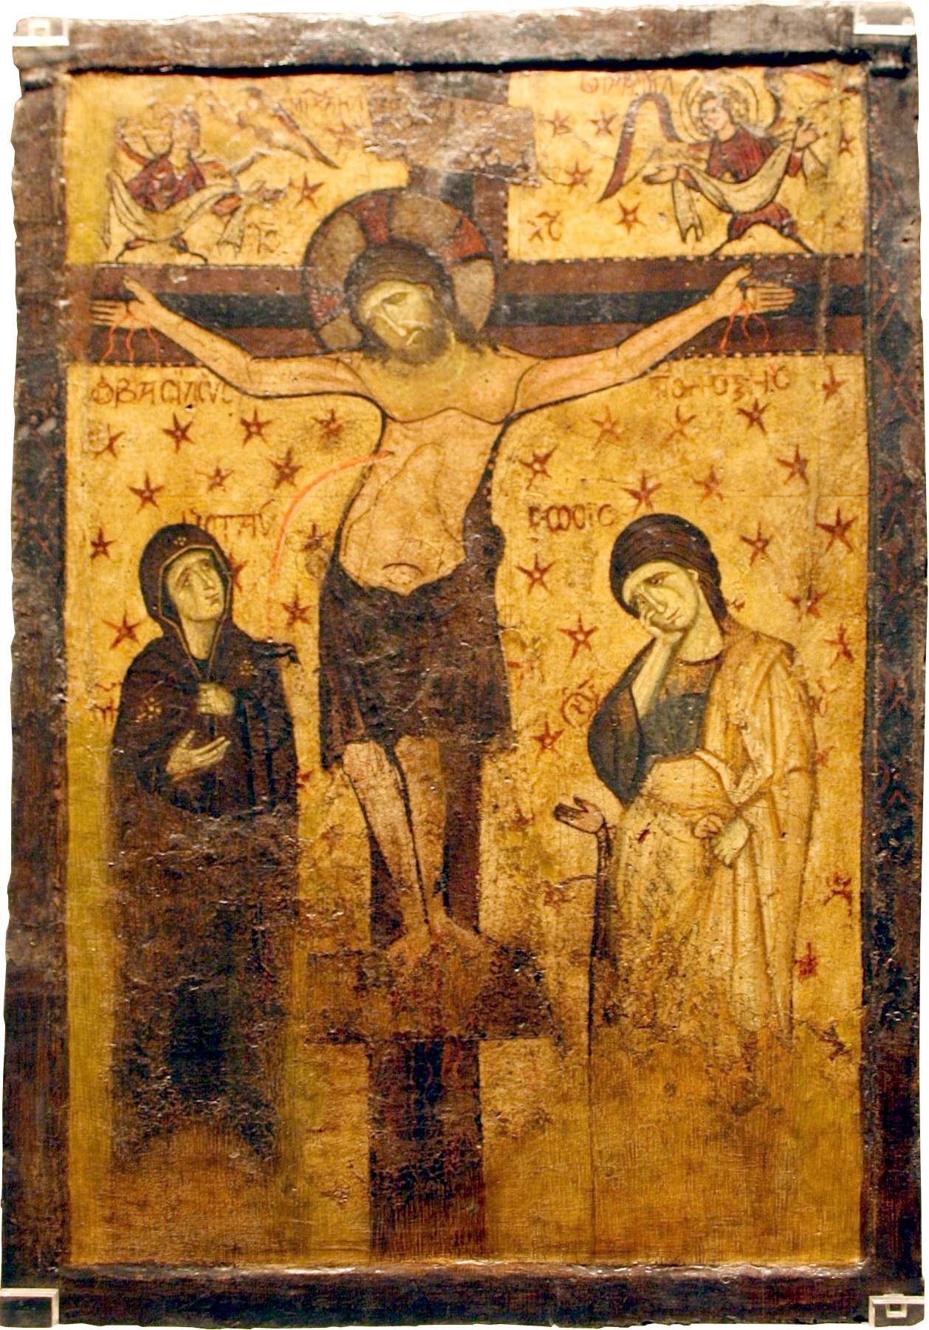
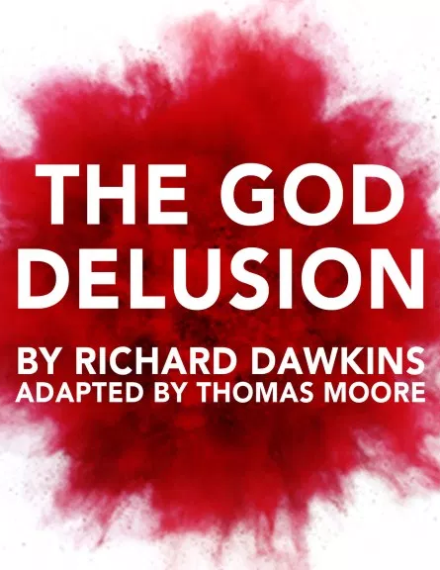

Slide 4
… join with me in suffering for the gospel, by the power of God. He has saved us and called us to a holy life – not because of anything we have done but because of his own purpose and grace. This grace was given us in Christ Jesus before the beginning of time, but it has now been revealed through the appearing of our Saviour, Christ Jesus, who has destroyed death and has brought life and immortality to light through the gospel.
2 Timothy 1:8-10

Slide 5
… to open their eyes and turn them from darkness to light, and from the power of Satan to God, so that they may receive forgiveness of sins and a place among those who are sanctified by faith in me.
Acts 26:18

Slide 6
World
Cultures …

Slide 7
Guilt-Innocence
World
Cultures …

Slide 8
Guilt-Innocence
Shame-Honour
World
Cultures …

Slide 9
Guilt-Innocence
Fear-Power
Shame-Honour
World
Cultures …

Slide 10
… to open their eyes and turn them from darkness to light, and from the power of Satan to God, so that they may receive forgiveness of sins and a place among those who are sanctified by faith in me.
Acts 26:18

